Slide 1

Automated Podcast Transcription and Topic Segmentation
Unlocking the full potential of audio content through cutting-edge AI, we explore how automated transcription and topic segmentation are revolutionising the podcast landscape. From enhancing accessibility to boosting discoverability, discover the innovations shaping the future of podcasting.

Slide 2

INSIGHT
The Podcast Boom & Its Challenges
Exponential Growth
Over 2 million active podcasts worldwide by 2026, marking a significant surge in audio content creation and consumption.
Navigation Hurdles
Long episode formats make it challenging for listeners to navigate content effectively and discover specific topics of interest.
Manual Workload
Traditional transcription and segmentation methods are extremely time-consuming and costly, hindering scalability for creators.

Slide 3


Why Transcription Matters
Improved Accessibility
Enhanced SEO & Repurposing
Transcripts provide vital access for deaf and hard-of-hearing listeners, ensuring inclusivity for all audiences.
Transcripts boost search engine optimisation and allow for versatile content repurposing into blogs, social media posts, and articles.
Quality Concerns
Raw automatic transcripts often suffer from errors and poor readability, necessitating further refinement for professional use.

Slide 4
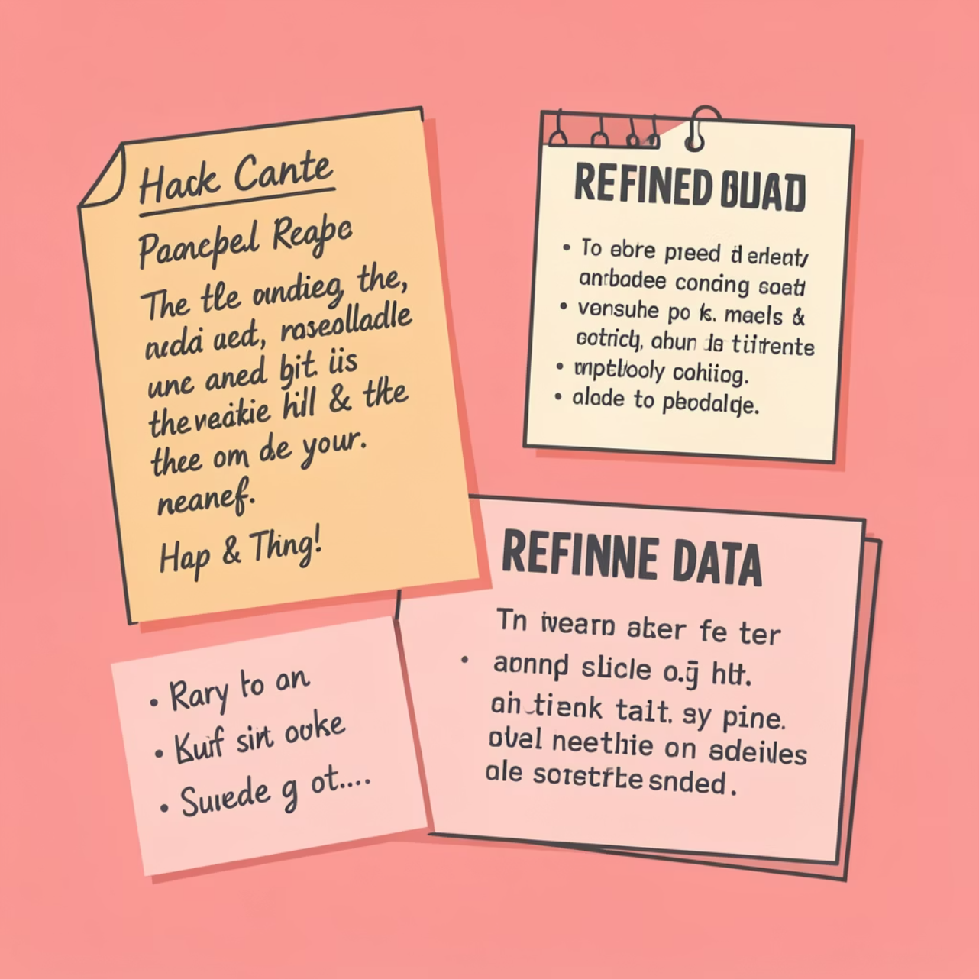
The Transcription Problem: From Audio to Clean Text
Speech-to-text models, such as OpenAI Whisper, have significantly accelerated the initial transcription process. However, the raw output often includes:
Repeated words and filler sounds (e.g., "um," "uh")
Misheard phrases due to accents or background noise
Lack of punctuation and grammatical errors
This necessitates extensive manual editing to produce readable and polished transcripts. Manual editing can consume several hours per episode, posing a significant challenge for solo podcasters and limiting their ability to scale content production effectively.

Slide 5
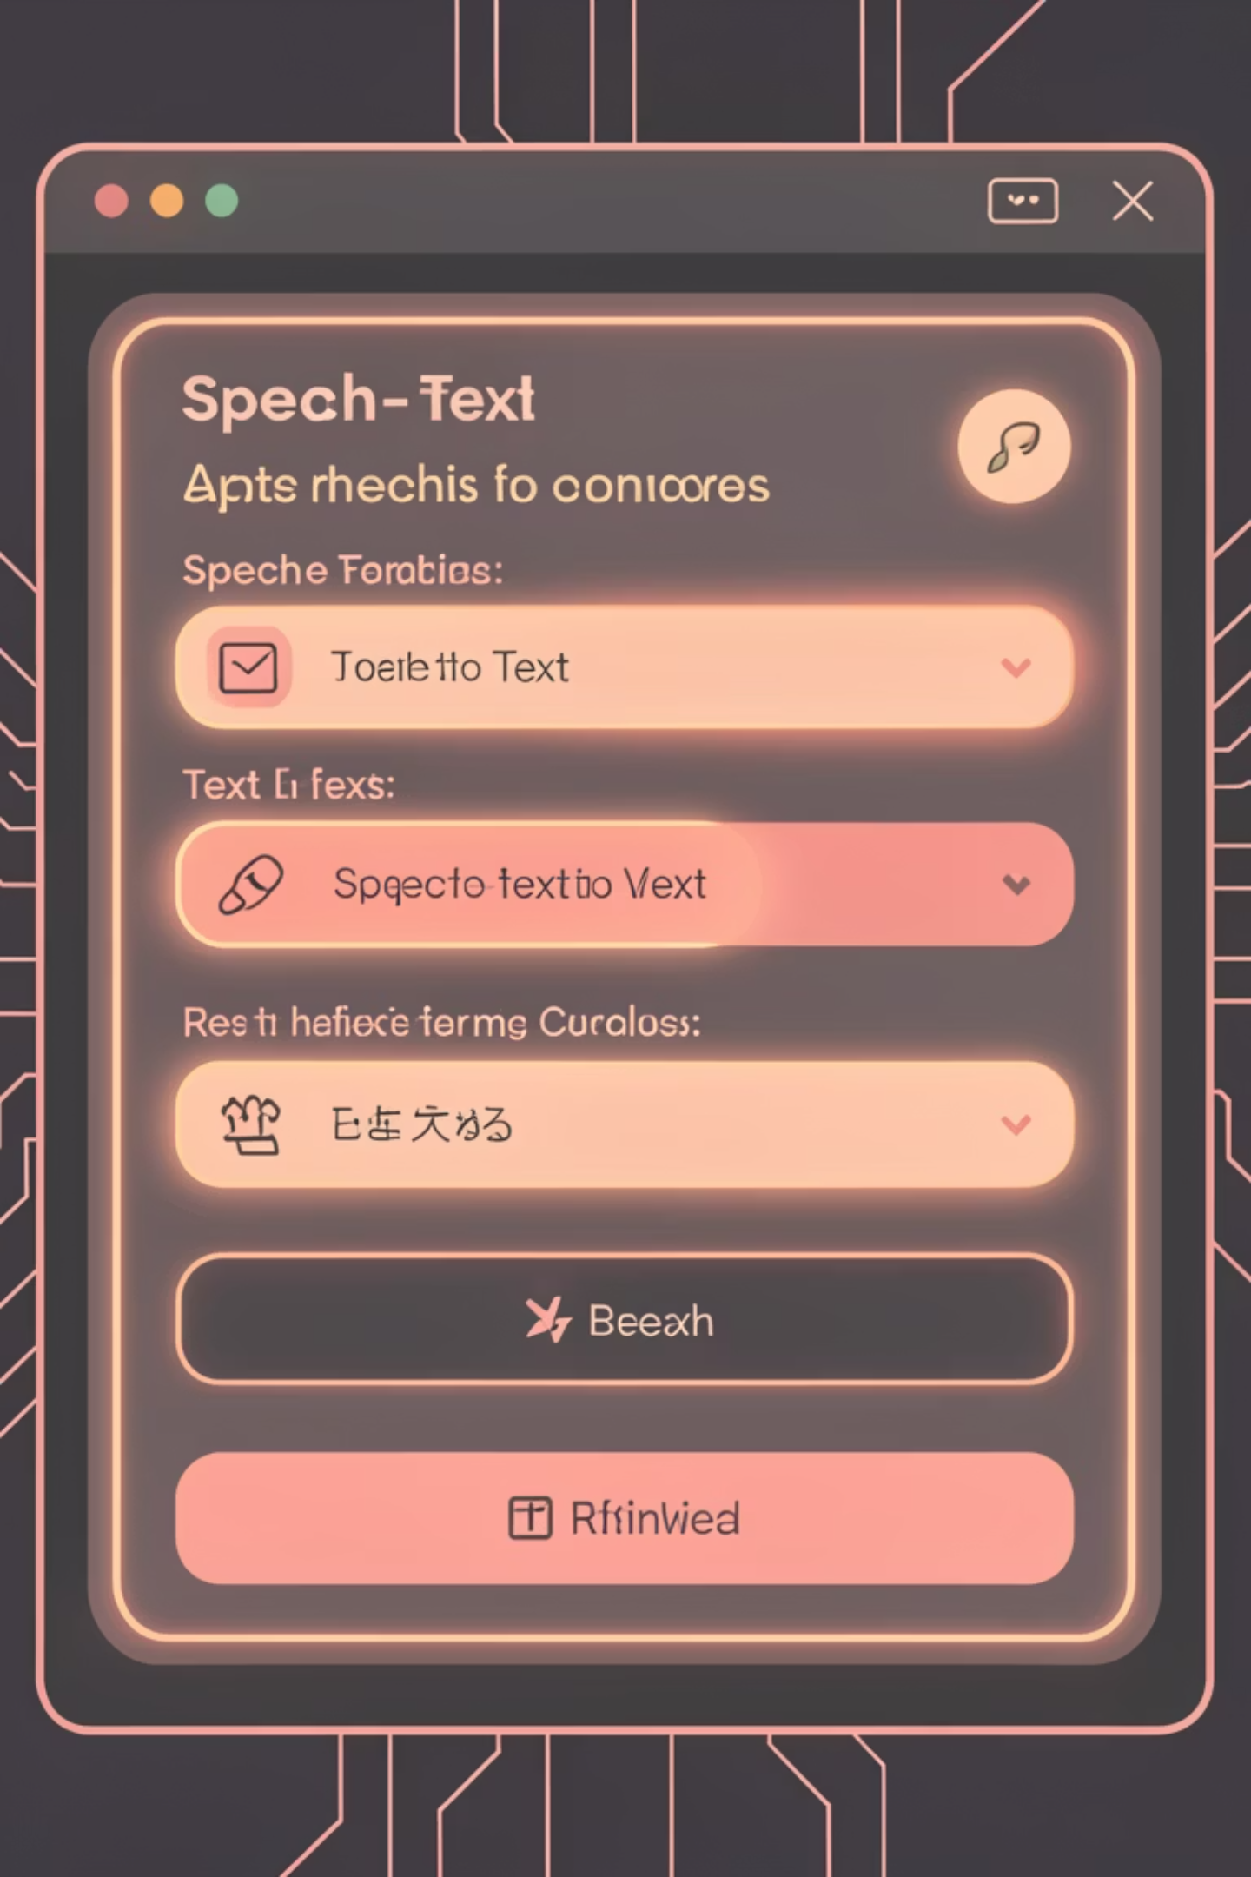



Enter AI-Powered Automation: Local & Cloud Solutions
Den Delimarsky's Pipeline
An innovative open-source pipeline leverages WhisperX alongside local Large Language Models (LLMs) for transcript cleanup.
AI-Driven Refinement
These advanced AI models meticulously identify and remove filler words, correct grammatical inaccuracies, and significantly improve the overall flow and coherence of the text.
Empowering Creators
This automation empowers podcasters to generate high-quality, professional-grade transcripts without the need for expensive and time-consuming manual editing, fostering greater scalability.

Slide 6

Topic Segmentation: The Next Frontier
Unstructured Conversations
Podcasts, by nature, often feature spontaneous and free-flowing conversations, lacking a rigid, pre-defined structure.
Listener Frustration
Without clear chapters or timestamps, listeners frequently struggle to locate specific segments or topics of interest within longer episodes.
Labor-Intensive Manual Efforts
The manual creation of chapters is a rare and highly laborious task, often neglected by creators due to the significant time investment required.

Slide 7
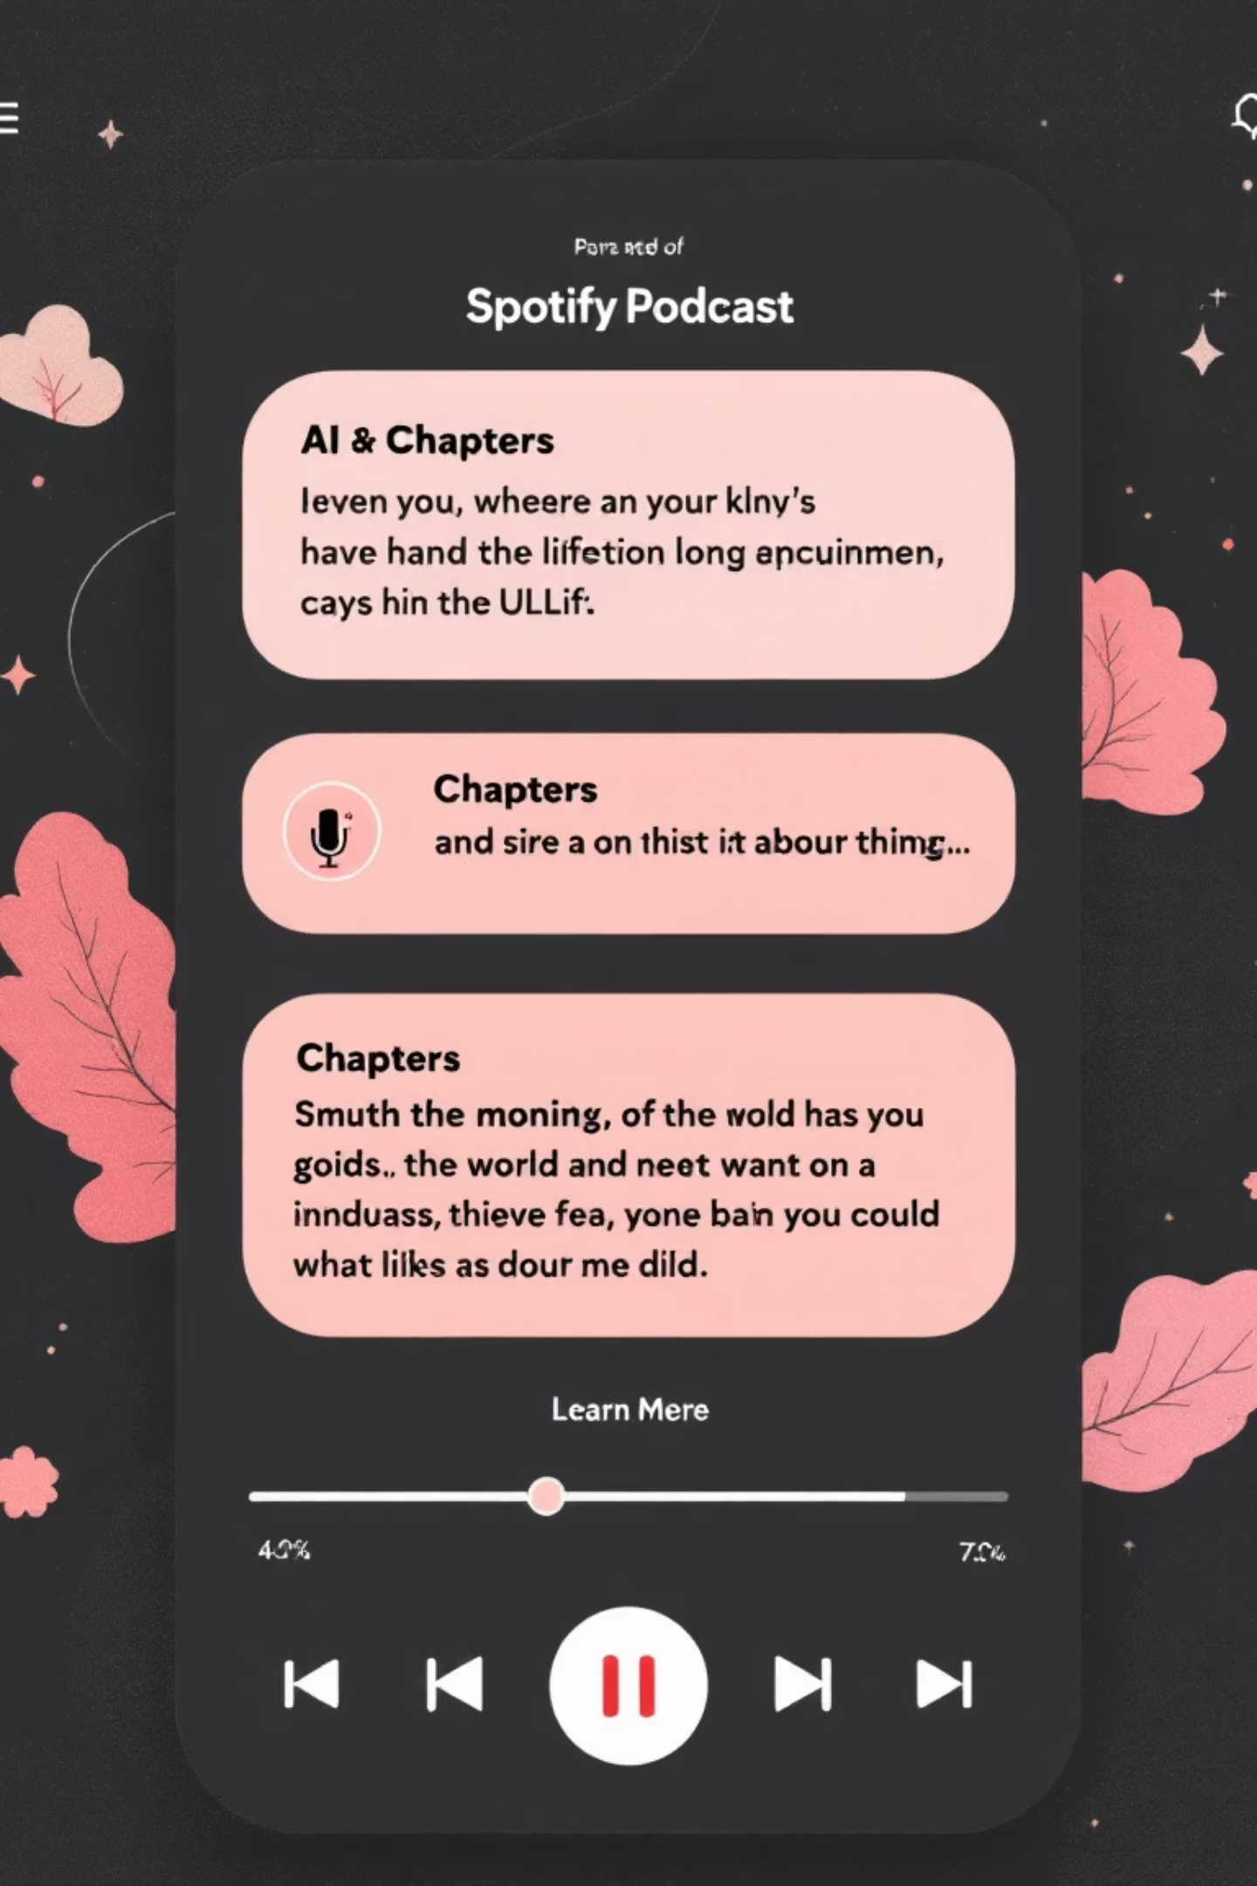
INNOVATION
PODTILE: AI-Driven Podcast Chapterization by Spotify
Advanced AI Model
PODTILE utilises a LongT5 transformer model, meticulously fine-tuned on an extensive dataset of over 21,000 podcast episodes.
Dual Prediction Capability
This model intelligently predicts both chapter boundaries and generates descriptive titles directly from episode transcripts.
Contextual Understanding
It incorporates global context (episode title, description) and dynamic context (previously generated chapters) for superior coherence and accuracy.
Significant Performance Boost
In rigorous evaluations, PODTILE achieved an impressive 11% ROUGE score improvement over traditional baseline models, showcasing its effectiveness.

Slide 8




Benefits of Automated Transcription & Segmentation
Enhanced Listener Experience
Accessibility Uplift
Time & Cost Savings
Improved Discoverability
Accurate and readable transcripts ensure that podcast content is universally accessible to all audiences, including those with hearing impairments.
Content creators can save weeks of manual effort per season, reallocating valuable time and resources to other creative pursuits.
Automated processes enhance the searchability of podcast content, making it easier for new listeners to find relevant episodes.
Effortless navigation through chapters and concise summaries significantly improves engagement and satisfaction.

Slide 9
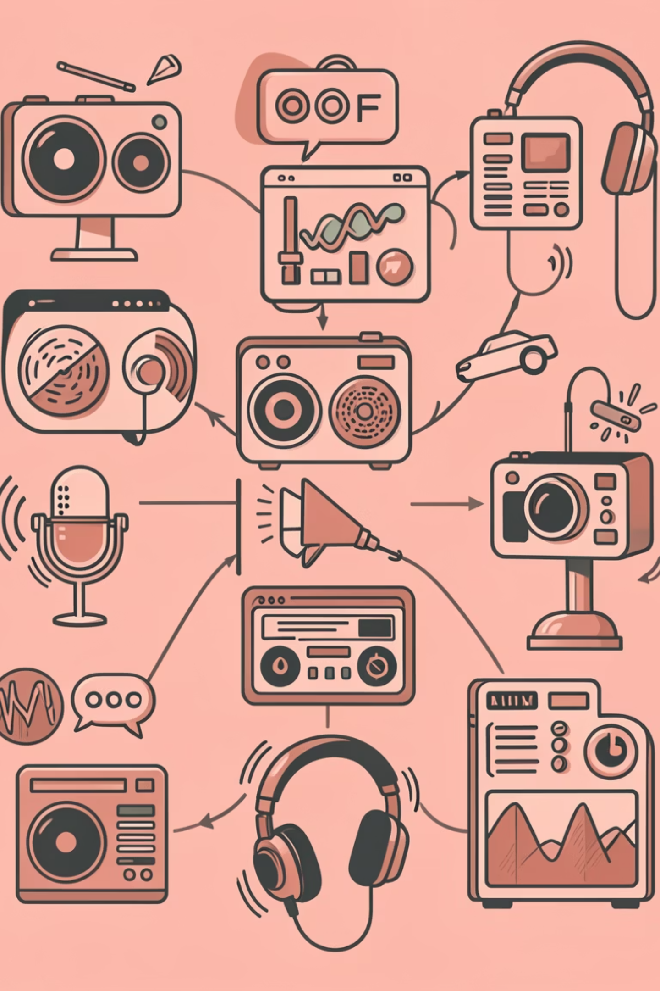
Real-World Impact & Tools Today
1
Open-Source Solutions
Tools like wendy7756/podcast-transcriber offer free AI-driven transcripts and summaries, democratising access to advanced features.
2
Platform Integrations
Platforms such as Blubrry provide seamless transcription add-ons, directly integrating with podcast hosting services for convenience.
3
Advanced AI Orchestration
Complex AI pipelines, orchestrated with tools like Airflow, combine Automated Speech Recognition (ASR), topic modelling, and recommendation systems for comprehensive solutions.
4
Growth in India
The Indian podcast ecosystem is rapidly adopting these technologies to reach its diverse audience base, fostering new avenues for content consumption.

Slide 10

FUTURE VISION
The Future: Smarter, Faster, More Inclusive Podcasts
Continuous AI Advancements
Real-time Capabilities
Ongoing improvements in speech recognition and Natural Language Processing (NLP) will refine accuracy and capabilities.
Expect real-time transcription and dynamic chapter updates, providing instant content navigation for live and on-demand podcasts.
Expanded Integration
Empowering Creators & Listeners
Further integration with multilingual support and sophisticated sentiment analysis will offer deeper insights and wider reach.
These innovations will collectively empower both content creators and listeners, unlocking the full, untapped potential of podcast content globally.

